Slide 1
Carol Muriithi
Identification of CDR regions in the heavy chain using SVM Models

Slide 2
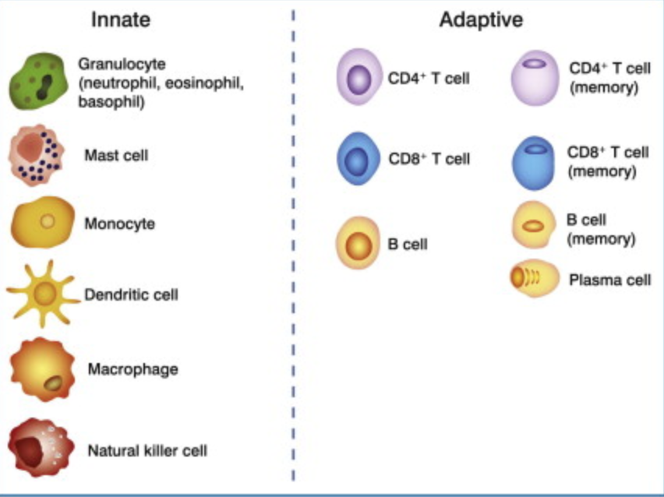
The Immune System
The immune system is made up of the innate immunity and acquired(adaptive immunity)
The innate immunity is quick, generalized and non-specific
The acquired immunity is specific and develops more slowly and only after an initial attack

Slide 3
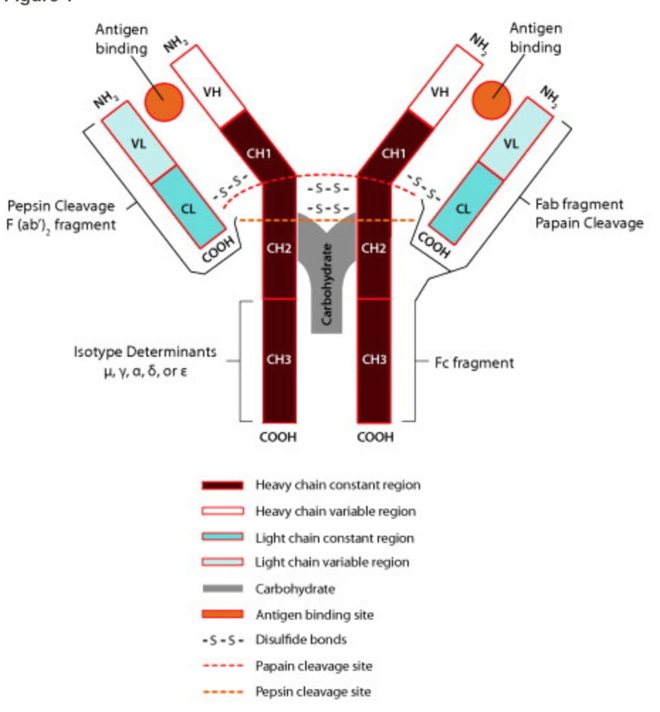
Acquired Immunity
Acquired immunity is further divided into 2 classes.
B-Cell immunity , also called humoral or antibody mediated immunity
T-Cell immunity, also called cell-mediated immunity

Slide 4
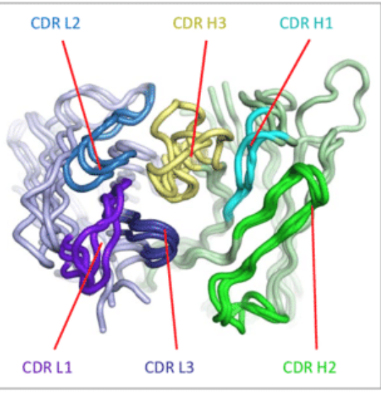
Complementarity-determining regions (CDRs)
CDRs are part of the variable chains. As the most variable parts of the molecules, they are crucial to the diversity of antigen specificities generated by lymphocytes.
They are 3 CDRs on the heavy chain; CDRH1, CDRH2 and CDRH3
B-lymphocytes and T-lymphocytes have antibody-like protein
Each B-Cell lymphocyte makes a single type of antibody(Ig) which binds to an antigen.
The portion of the antibody that binds to an antigen is highly specific for that antigen and is called an antigenic determinant. ²

Slide 5
Methods: SVM(Supervised Machine Learning)
Dividing of Testing and Training data
N_Test | 22,114
N_Train | 51,600
 | ~Residue Start | Residue before | Residue After | Residue Length
CDRH1 | 26 | Cys(C) | Trp (W) Trp-Val, Trp-Ile,Trp-Ala | 10-12
CDRH2 | 15 after end of CDRH1 | Leu-Glu-Trp-Ile-Gly | Lys/Arg-Leu/Ile/Val/Phe/Thr/Ser/Ile/Ala | 16-19
CDRH3 | 33 after end of CDRH2 | Cys(C) | Trp-Gly-xxx-Gly | 3-25
Chothia/Abm/kABAT Definitions

Slide 6
Feature Engineering
For testing and dividing data, we took a subset of the data as testing and training data; trainsubset and testsubset
We used the same conditions( CDRH1, CDH22 and CDRH3) for the features and binarized our data; assigning 0 or 1 if the features were present for every condition
I created a 4th feature by including a the following motif which was consistent H103(j) == ‘W’, H104(j) == 'G' && H105(j) == 'Q' || H105(j) == 'T’) and H106(j) == ‘G’ and binarized the out put
SVM was then used to analyze and process the data and create a model that can predict CDR regions.

Slide 7
Results and Discussion
SVM Post Processing Model for feature engineering
Accuracy | 1
Specificity | 1
Sensitivity | 0
Post Processing Model for the entire data set
Accuracy | 0.731
Sensitivity | 0
Specificity | 1

Slide 8
Discussion
Most of the sequence variation that is associated with antibodies and T cell receptors are found in the CDRs with CDR3 being the most variable.
A drawback of the Kabat, Chothia, and IMGT numbering schemes is that CDRs length variability takes into account only the most common loop lengths.
Our low sensitivity values for the CDR regions could be accounted for by research that alludes that Non-CDR Determinants have a role in Ag Binding

Slide 9
Discussion
It was also interesting to see that after including neighboring regions of CDRH3, the accuracy for the SVM model improved.

Slide 10
References
Yu, H. Analyzing antibody sequence for recombinant antibody experience. GenScript.20 March, 2015.
Culang, S.et al. The Structural Basis of Antibody-Antigen Recognition. Front Immuol. 8 Oct 2013, 4:302; doi: [10.3389/fimmu.2013.00302]
Group Members: Ahmed, Prisma, Zainab.
Questions?

